Slide 1








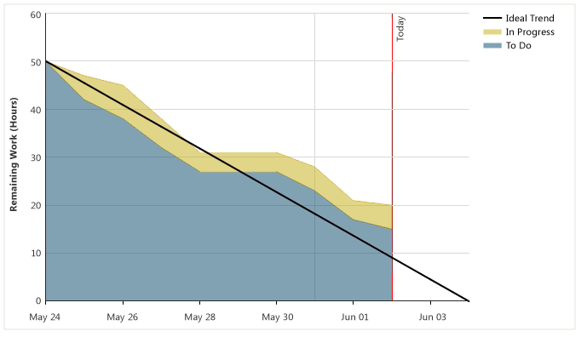
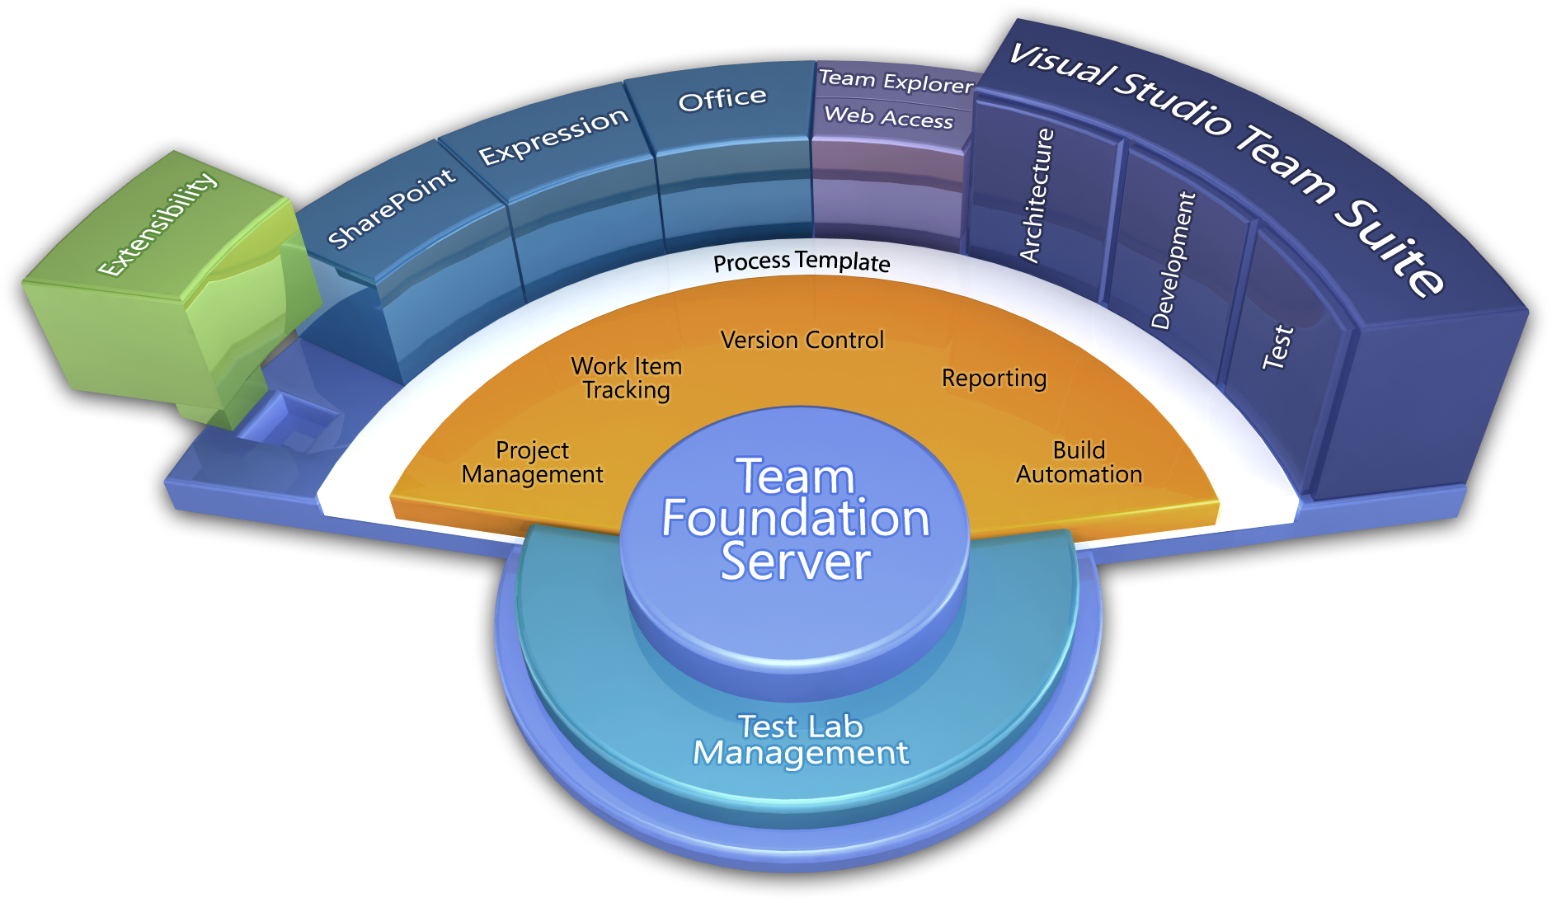
Enterprise Team Foundation Server
Overview
Enterprise Team Foundation Server is corporately available infrastructure in 3M Data Centers that provides a full ALM suite of tools including source code management, requirements management, project management, build services, lab management, testing, and release management capabilities.
Source Control
Requirements Management
Reporting
Release Management
Work Management
Supports Scrum,
Customize your workflow
Report on progress
Rollup Reporting across projects
Project Management
Build Services
Testing
Cross platform support
Source Control
Multi-platform support (Windows, Xcode, Eclipse)
TFVC or Git support
Process / Optimization
Project Management
Requirements Management
Design & Architecture
Release Management
Development
QA & Test
Application Lifecycle Management using Enterprise Team Foundation Server provides practices to manage application lifecycle. Manage source code across teams, develop, build, and test applications – plan projects, track work, and report progress.
Application Lifecycle Management (ALM)
Want to learn more?
Enterprise TFS http://tfs.mmm.com

